Slide 1
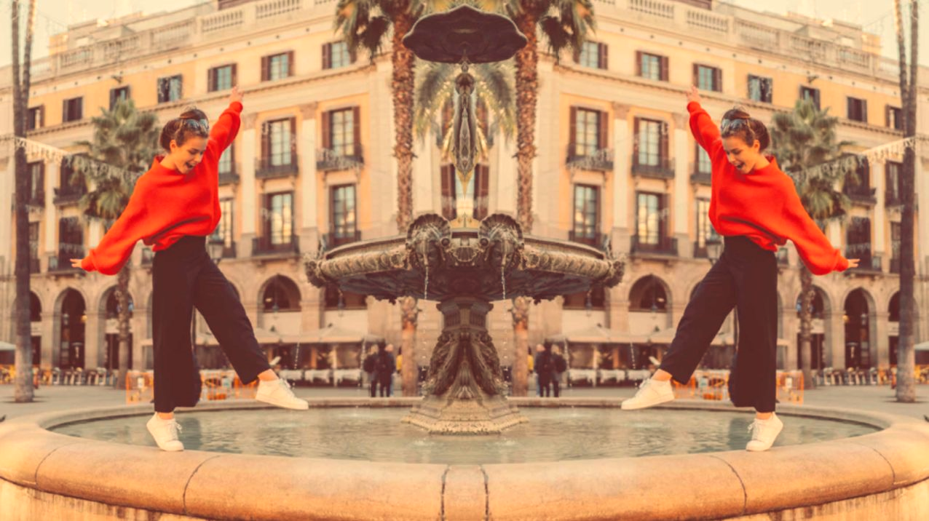
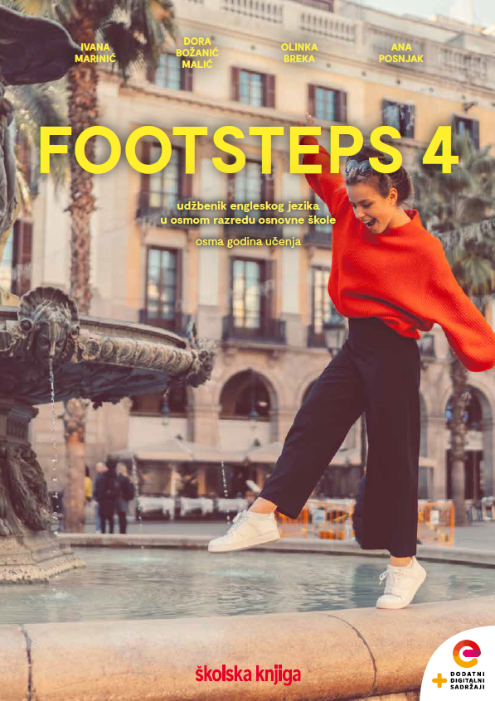

UNIT 5;
Tick tock
Lesson 6;
A CV writing

Slide 2
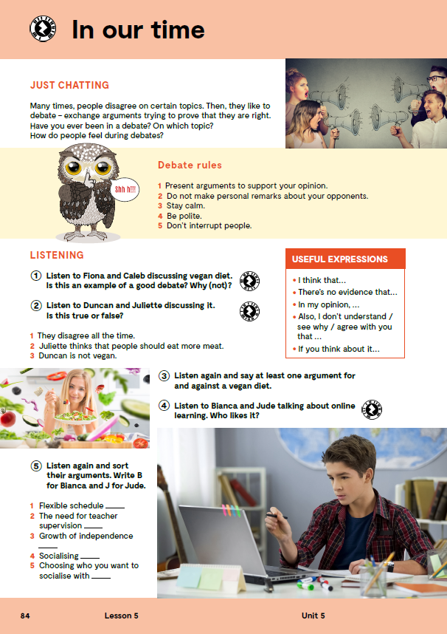
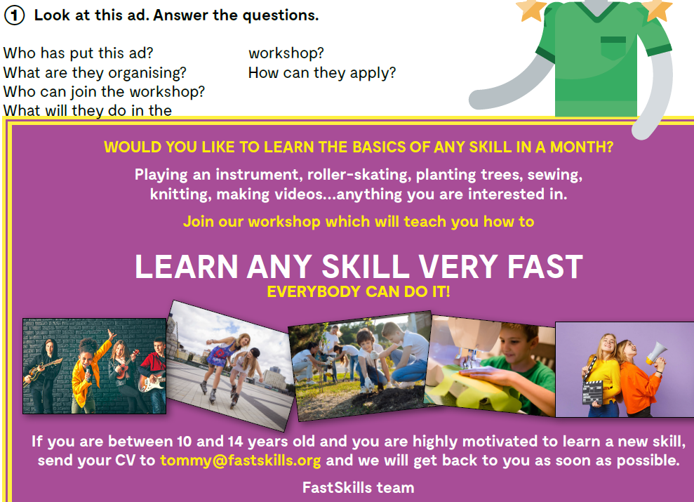
Do you know the meaning of these expressions?
hard skills
soft skills
personal
information
profile
CV
apply
vještine koje učimo na tečajevima, ili su povezane sa znanjem
vještine suradnje s drugima, npr. komunikacijske i kolaboracijske vještine
osobne
informacije
profil
životopis
prijaviti se

Slide 3
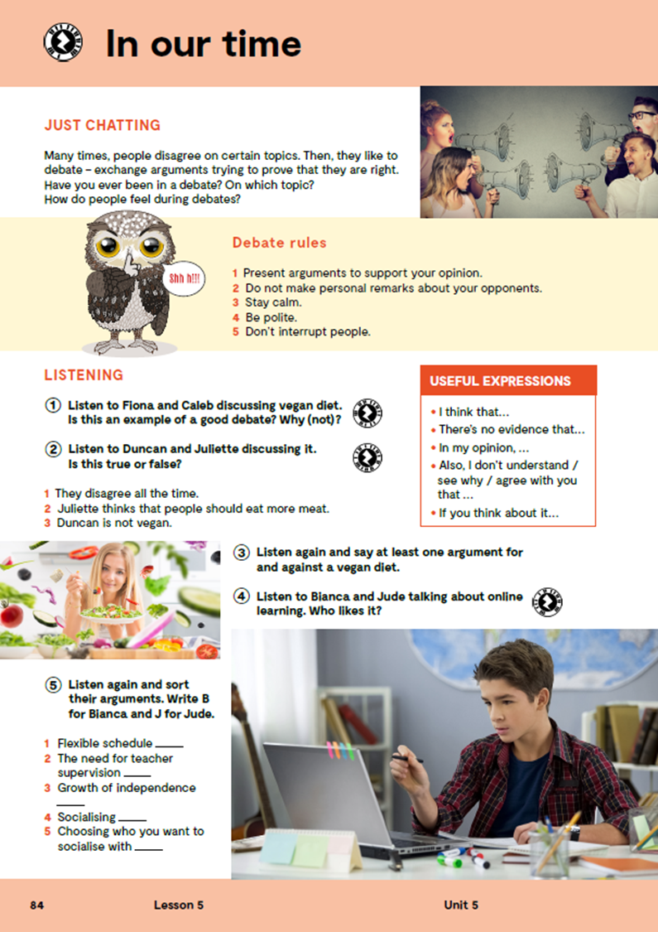
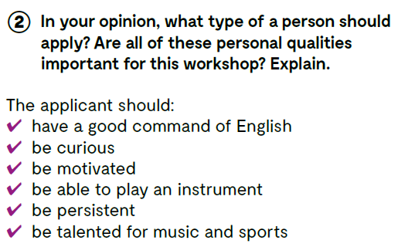

Slide 4
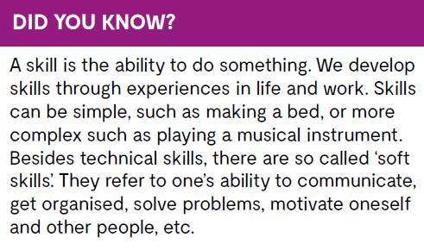

Slide 5
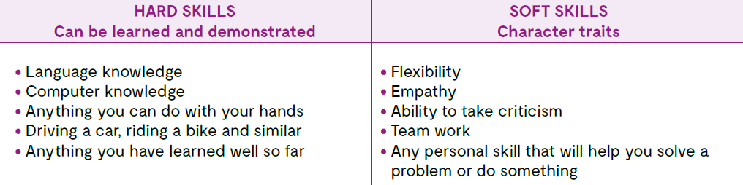

Slide 6
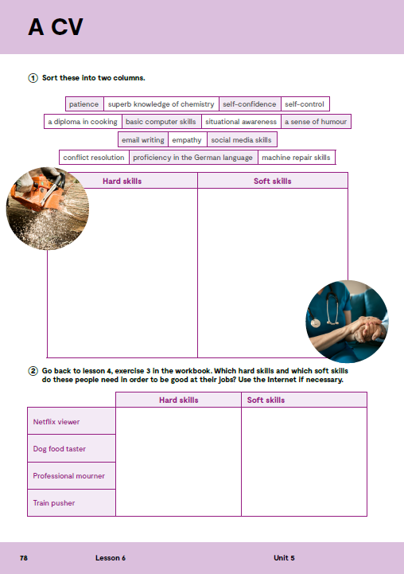
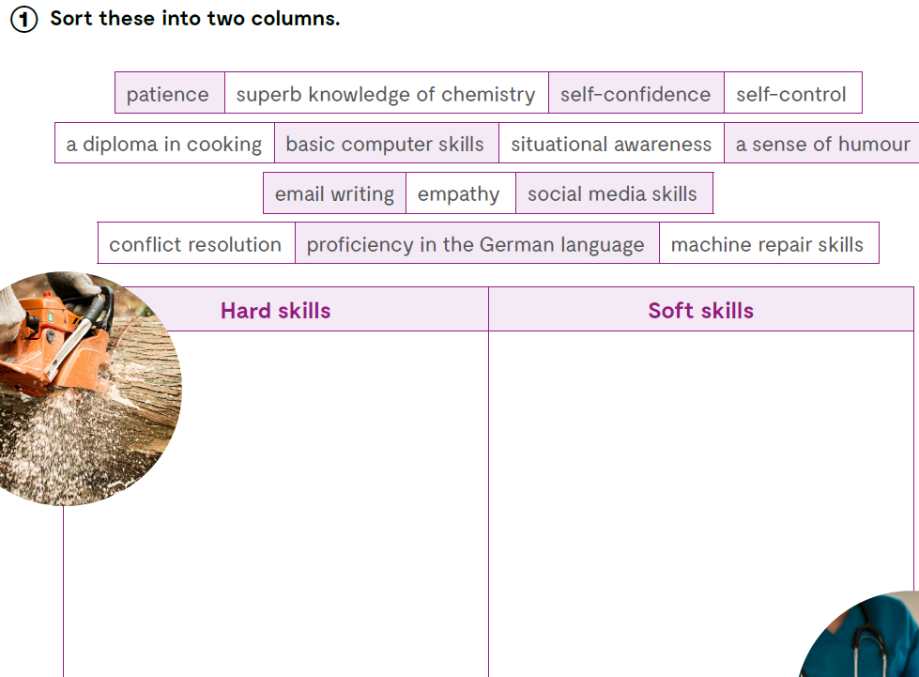
Open your exercise book, page 78.
superb knowledge
of chemistry
patience
self-confidence
self-control
a diploma in cooking
basic computer skills
situational awareness
a sense of humour
email writing
social media skills
empathy
proficiency in the German language
machine repair skills
conflict resolution

Slide 7
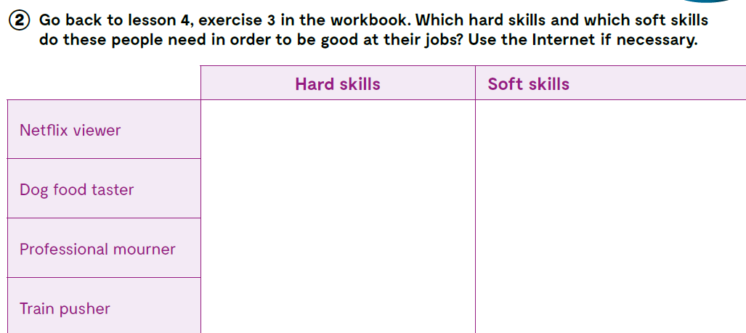

Slide 8
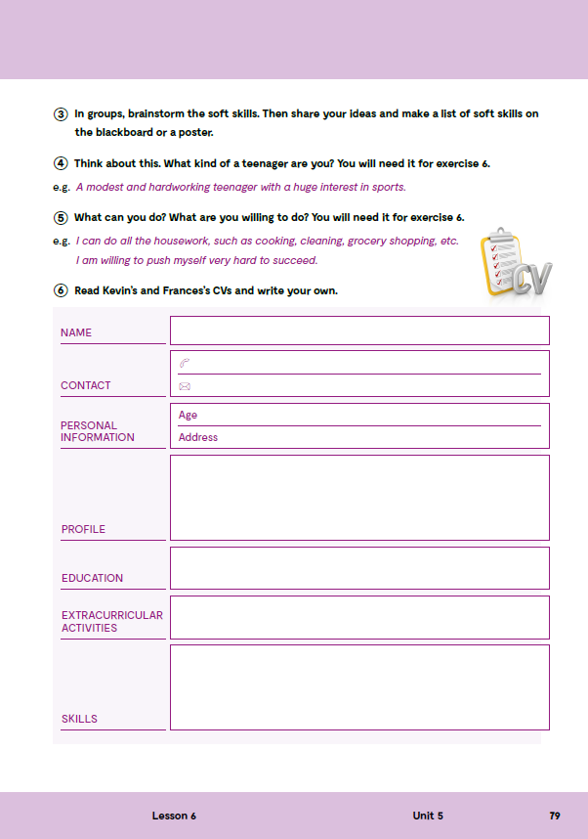

Check what you have learnt. https://wordwall.net/play/13113/344/281
Open the following link and then click on LEARN MORE!
https://www.e-sfera.hr/dodatni-digitalni-sadrzaji/be11e323-b470-4b54-80e5-ecc75aa03917/
Transferable skills
Read the texts and do the tasks bellow the text.

Slide 9
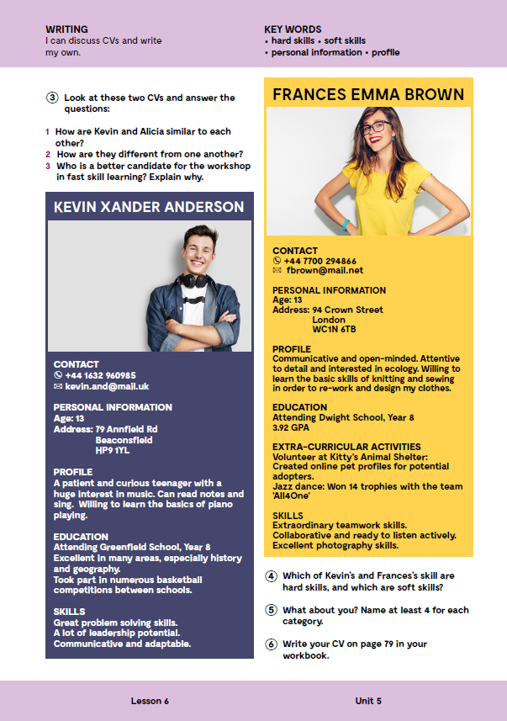
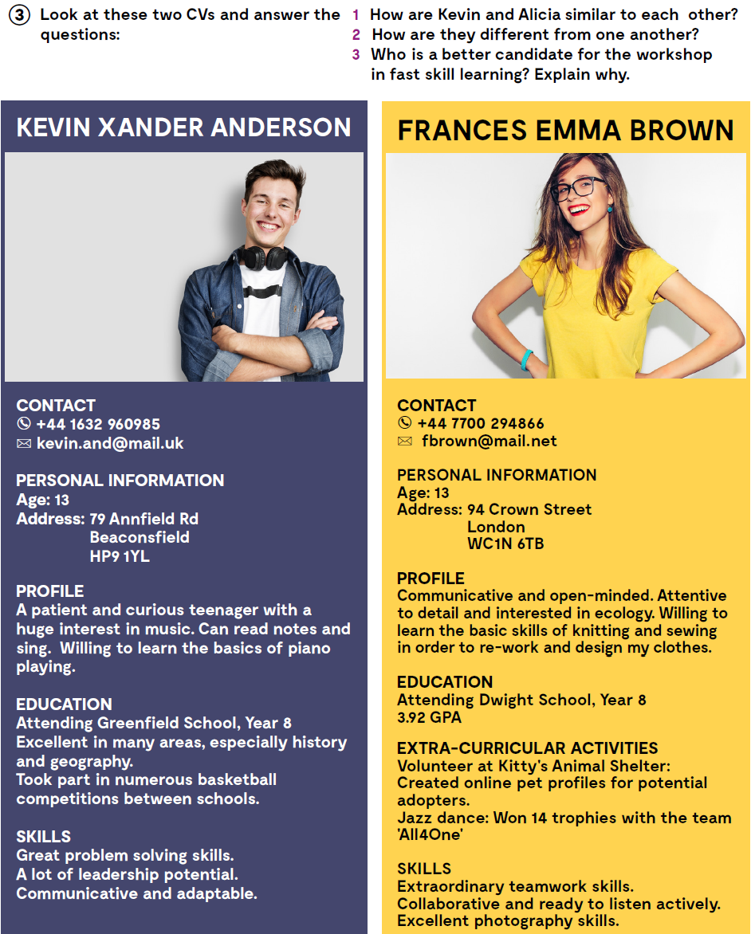


Open your book, page 87.
Look at these two CVs and answer the questions:
1 How are Kevin and Alicia similar to each other?
2 How are they different from one another?
3 Who is a better candidate for the workshop in fast skill learning? Explain why.
Which of Kevin’s and Frances’s skill are hard skills, and which are soft skills?
What about you? Name at least 4 for each category?

Slide 10

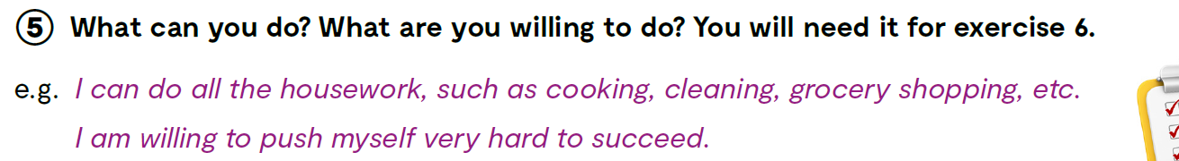
WORKBOOK, page 79.

Slide 11
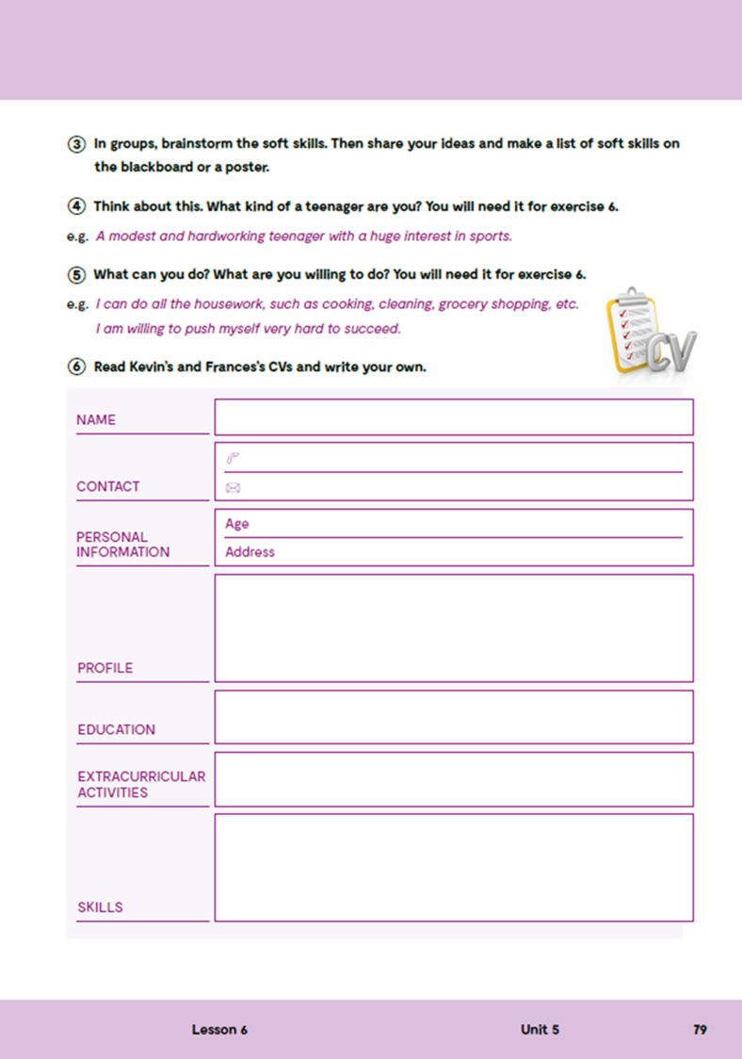
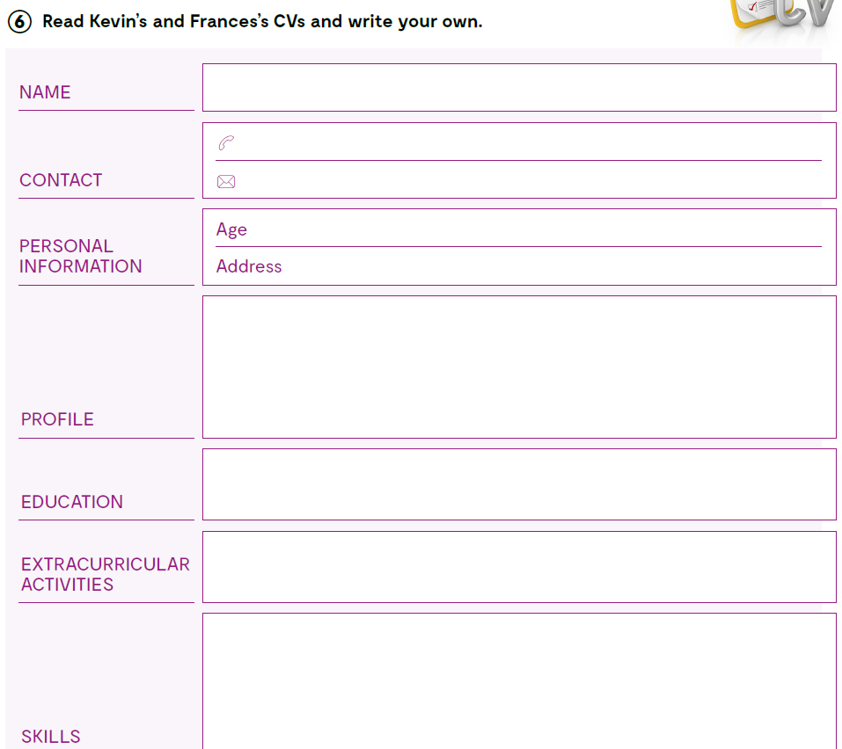
Read Kevin’s and Frances’s CVs and write your own.
In the next two weeks try learning one of these skills: moonwalking, juggling three balls, whistling with your fingers, folding your shirts very fast, tie a tie, say the alphabet backwards:
moonwalking,
juggling three balls,
whistling with your fingers,
folding your shirts very fast,
tie a tie,
say the alphabet backwards

